Slide 1
Commercial Performance Analysis
Identifying Growth Levers Across Products, Channels, and Accounts
Prepared By-Samina Pacha.

Slide 2
Objective & Challenges Addressed
Objective:
  Diagnose true revenue drivers
  identify the highest-ROI levers to reignite growth.
Key Business Challenge:
  Plateauing topline performance
  Uneven growth across regions, SKUs, and channels

Slide 3
Approach Taken
Analyze revenue and quantity trends (6–8 quarters)
Assess channel and account-level contribution
Observe SKU distribution throughout all the Zones.
Recommend actionable plan

Slide 4
Overall Revenue & Volume Trends - 1
Chart 1: Revenue vs Quantity by Quarter

Slide 5
Overall Revenue & Volume Trends - 2
Chart 2: QoQ Growth %

Slide 6
Overall Revenue & Volume Trends-3
Key Insights:
  The year started with an impressive growth of 10% across all the channels for the Quarter 1 of FY23-24.
  Even though the quantity sold looked impressive, it still failed to hit the mark of achieving the quarterly target and it plummeted negative results.
  This is the common pattern observed consecutively for over 7 Quarters with the results ranging only in single digit achievement, whether negatively or positively, highlighting a flat or plateau phase (no growth observed).
  Target Achievement fuelled majorly by the B2B accounts.

Slide 7
Product Group Performance
Here, we studied and reviewed over 422 product groups which have distributed over all the 4 zones.
While analysing using the Pareto Analysis, it has been found that about 55 Product Groups amount for about the 80% of the revenue.
Those 55 Product Groups are spread through the 3 main Channels and sum up to the major top 5 accounts contributing to the 60% of the revenue.

Slide 8
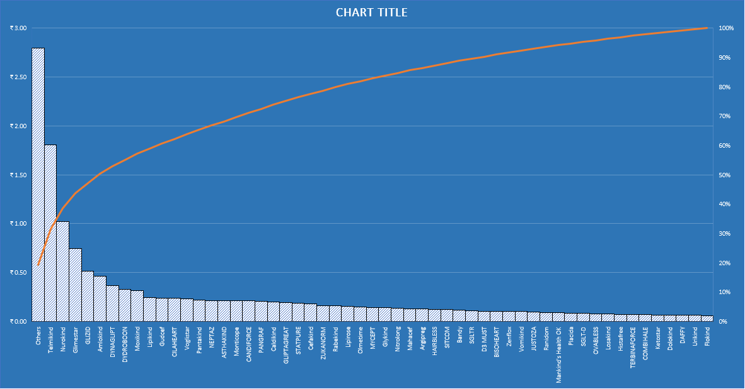
Product Group Performance - 2

Slide 9
Channel & Account Analysis - 1
Channel | Revenue Share (Estimated) | Revenue Share (Achieved) | Key Accounts
B2B | 28% | 38% | Ascent
Retail Chains | 32% | 41% | MedPlus, Apollo, Wellness.
E-commerce | 40% | 21% | Sastasun, Tata 1mg

Slide 10
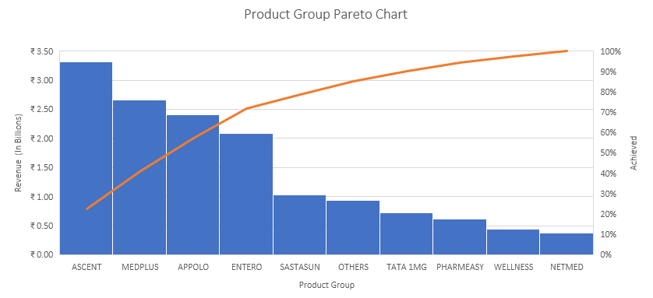
Channel & Account Analysis - 2
This very well explains how the 80/20 really works and how adopting it provides you the focus as well as helps you prioritize the cash flowing accounts.
The above analysis is conducted by understanding the pattern observed in the Product Groups; which helps us understand the important accounts that harbor the revenue streams.
As mentioned, the top 5 accounts do contribute to the 60%; however, the above 10 accounts contribute to more than 80% revenue, where the biggest Account belongs to the B2B Channel.

Slide 11
Channel & Account Analysis - 3
Key Insights :
  Initial expectation of E-commerce dominance was too high.
  E-commerce dramatically underperformed its estimated share by almost 50%.
  The B2B and Retail Channels outperformed their revenue expectation and are the true stabilizers of the business.

Slide 12
Zonal Distribution of Product SKUs.
The Highest quantity of SKUs sold in the Southern-2 zone of the entire country amongst the complete Product Group
The Highest number of SKUs are sold by Telmikind Product Group.

Slide 13
Recommended Action Plan and Insights
Focus on Targeting new accounts in the Ecommerce sector to increase the sales such as Consumer Centric Platforms for the promotion of Nutraceuticals Segment, since people have started being mindful of their Well-Being and practicing ‘Clean Eating and Healthy Living’.
Start Incentives and Partnership deals with Content Creators to bring more awareness about the Nutraceuticals sector as people as more present on the digital platforms.
The Zonal distribution of SKUs helped in understanding of the preferences of product groups amongst different Geographical Zones, thus, instead of focusing on all the groups, we should focus on providing seasonal offers as well as bundle deals to the loyal consumers of the particular Segments based on the seasons change.
Induce an active participation in Sponsorship of the Sports Events for the promotion of the products relevant to maintain a better lifestyle by distribution trial packets for the consumers to feel and use the product.
Partner with Quick Commerce platforms to distribute sample packs with a certain order value as to get in the mind of the consumer. This helps in the easy promotion of the product.

Slide 14
Recommended Action Plan and Insights - 2
Keeping in mind the budget spent of 6Cr. for previous FY, we have allocated a budget of 10 Cr. this FY, allowing us to be in 4Cr. surplus. Refer the below bifurcation to achieve new growth:
Channel | Last FY Allocation (Based on 6 Cr total) | Next FY Proposed Budget (10 Cr total) | Absolute Change | Change (%)
B2B | 28% →1.68 Cr | 3.5 Cr | +1.82 Cr | +108%
Retail Chains | 32% →1.92 Cr | 3.5 Cr | +1.58 Cr | +82%
E-commerce | 40% →2.40 Cr | 3.0 Cr | +0.60 Cr | +25%
TOTAL | 6.0 Cr | 10.0 Cr | 4.0 Cr

Slide 15
Recommended Action Plan and Insights -3
The Rationale behind the shown allocations:
As B2B are proven to be high-performers, the focus should be on JBP (Joint Business Planning) to secure better payment terms and exclusivity/shelf space for the 55 key SKUs.
Retails Chains have proven to be efficient time over time. Now, we must invest in in-store promotions and JBP for top chains (MedPlus, Apollo) to drive trial of 55 key SKUs in Southern-2 and other high-potential zones.
Ecommerce is still a growing channel. We must shift investments from generic deep discounts to targeted Nutraceuticals awareness (Content Creators, Quick Commerce Samples). The increase is low to limit risk and focus only on awareness/trial promotion, not price.

Slide 16
The End.

